Slide 1
Activity 4: FEATURE EXTRACTION FROM IMAGES USING IMAGEJ
Genesis Vertudez – 202003099
App Physics 157 - Computational Analysis and Modeling in Physics
Submitted to Dr. Maricor Soriano; Mx. Rene Principe Jr.

Slide 2
OBJECTIVES
Use ImageJ to manipulate images and extract their features
Apply threshold to grayscale histogram to separate objects from background

Slide 3
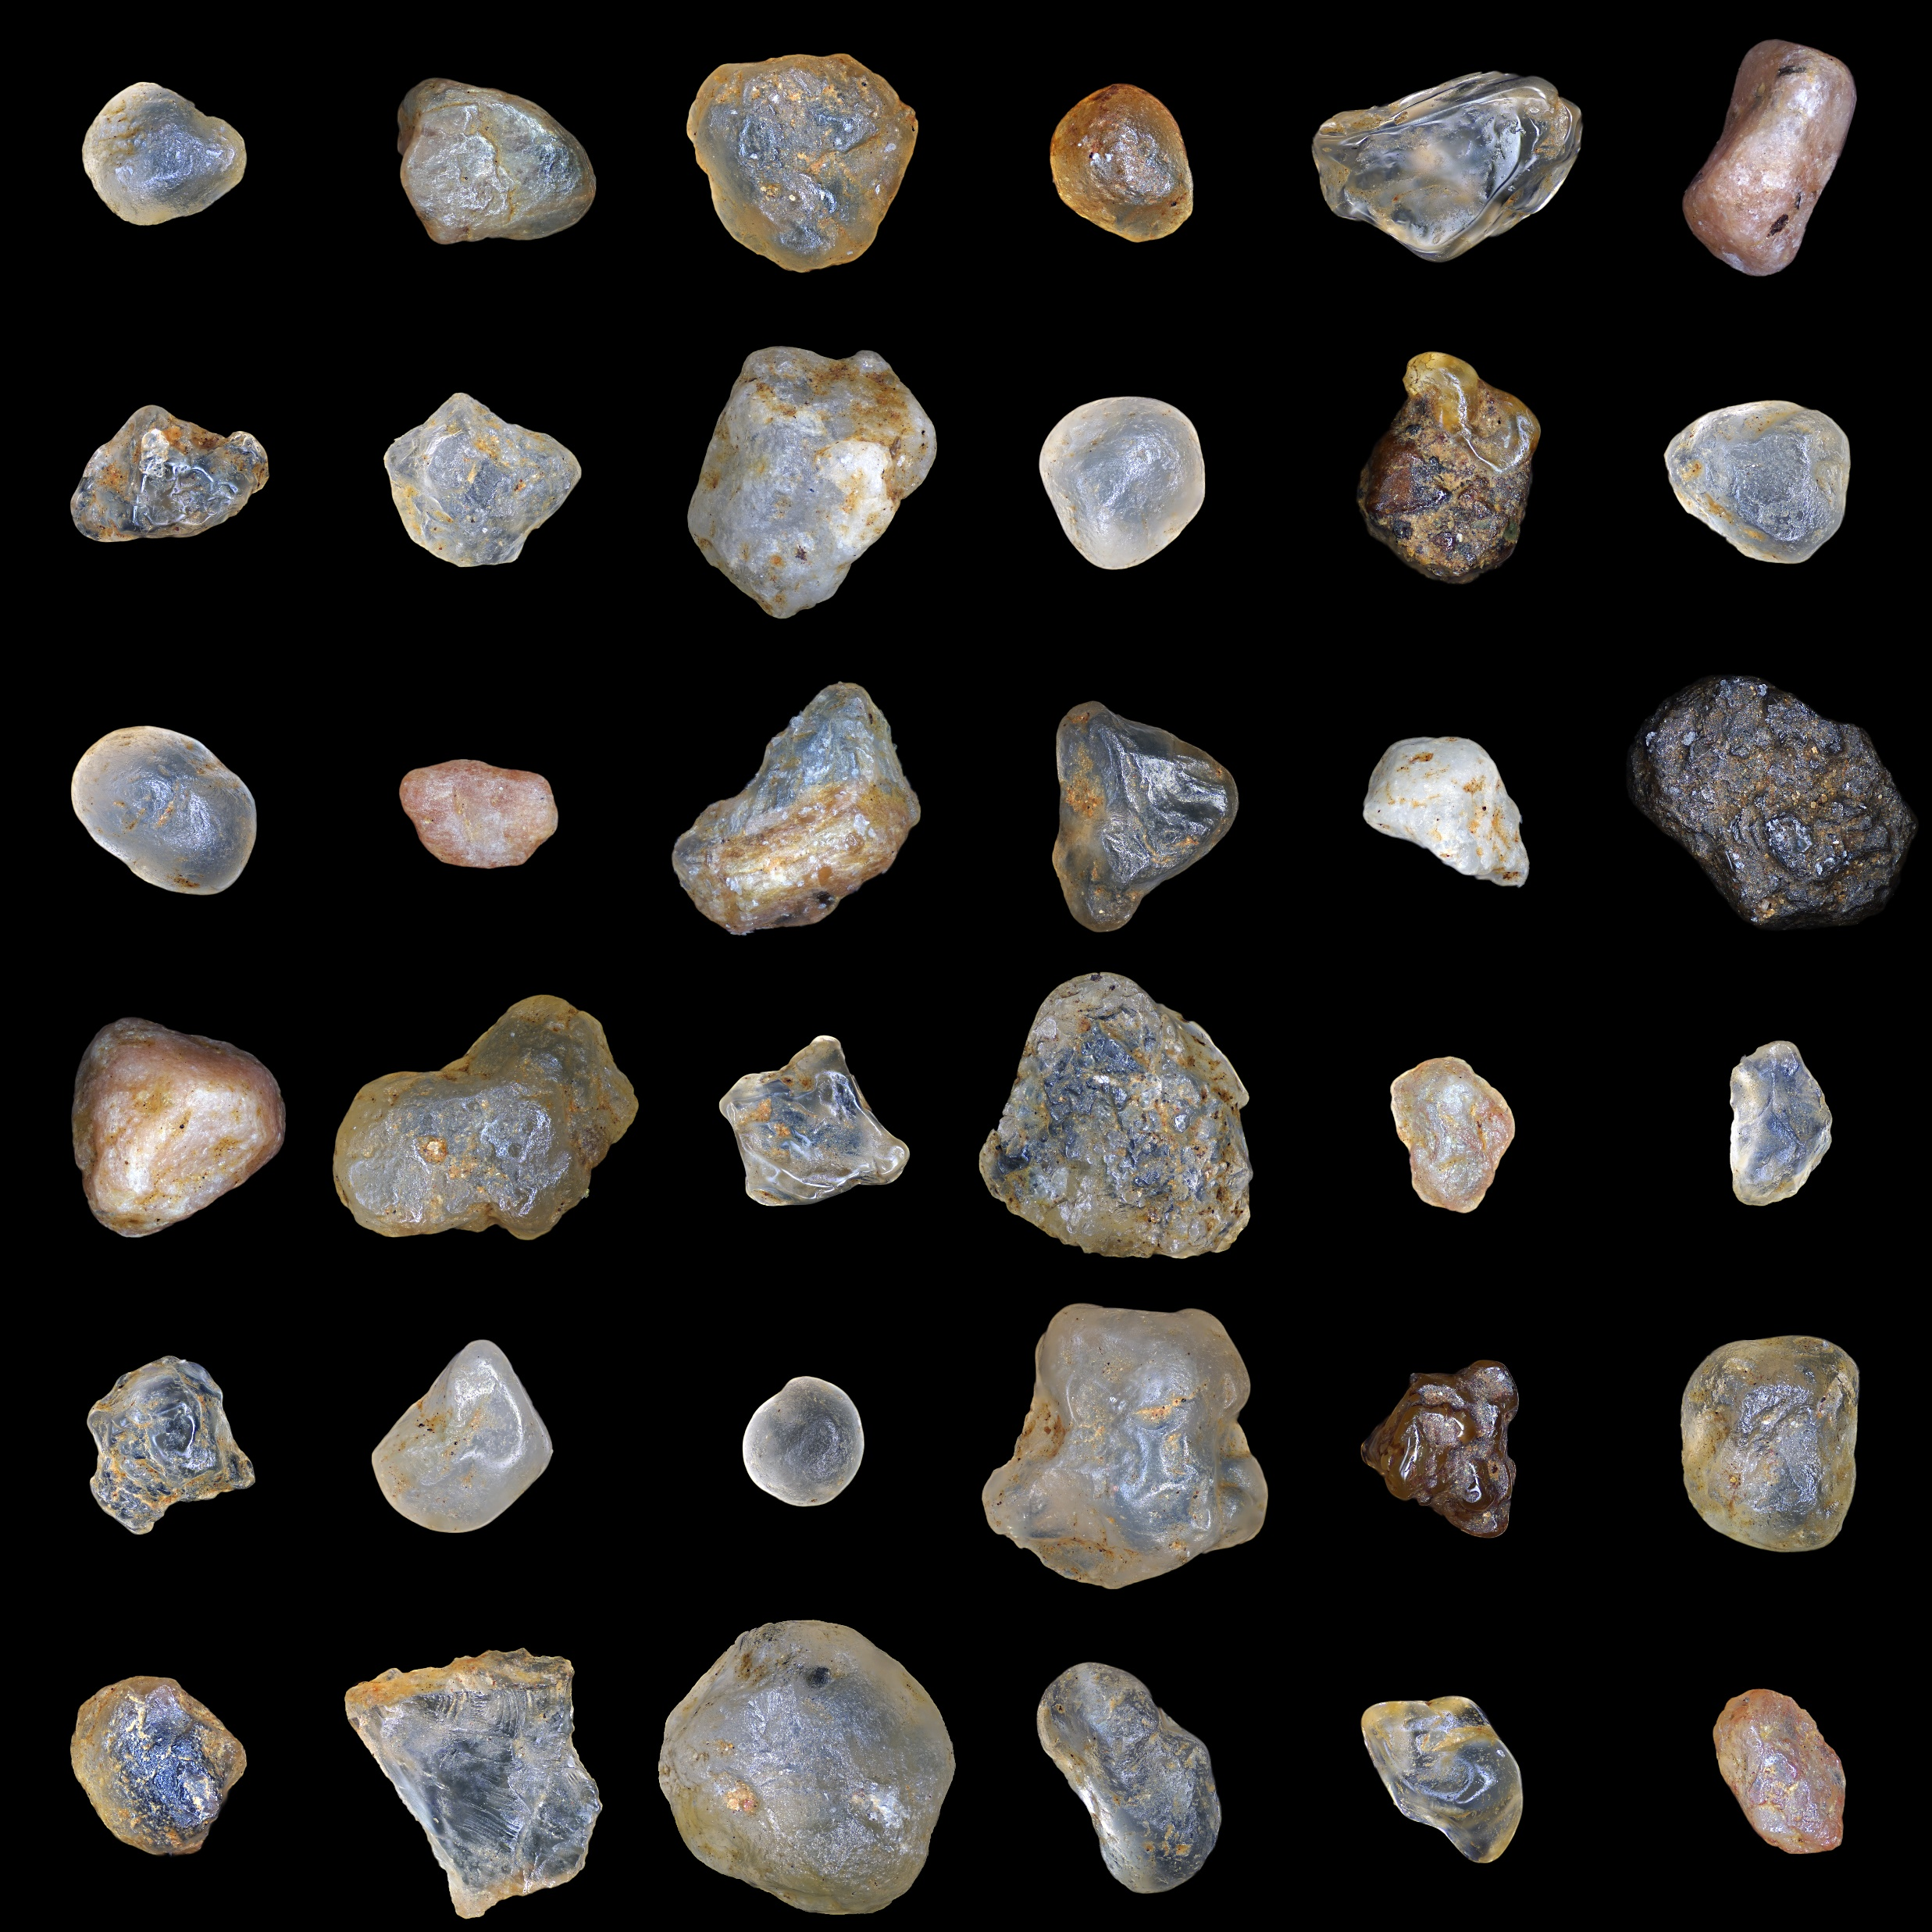
RESULTS & ANALYSIS
Image of sand particles
Files: https://github.com/genvert/AP_157_FX-2_Vertudez/tree/main/Activity%202

Slide 4
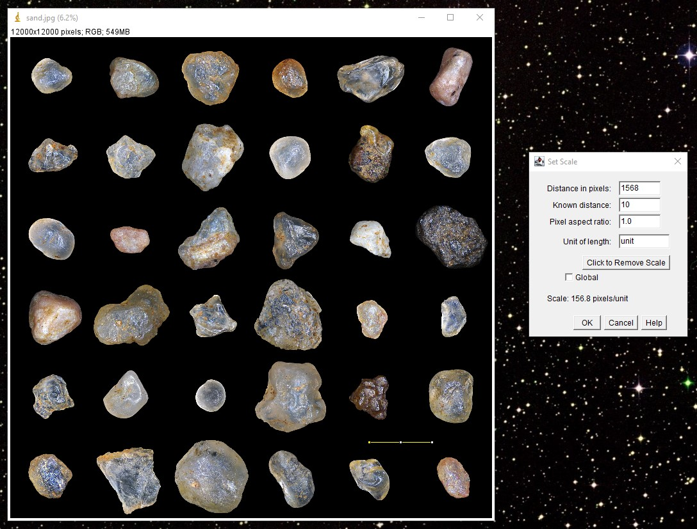
RESULTS & ANALYSIS
Setting scale
I just set an arbitrary scale as instructed. I used 10 units for about the same distance in the cell example.
Codes and files: https://github.com/genvert/AP_157_FX-2_Vertudez/tree/main/Activity%202

Slide 5
RESULTS & ANALYSIS
Converting to 8-bit
hj
Codes and files: https://github.com/genvert/AP_157_FX-2_Vertudez/tree/main/Activity%202

Slide 6
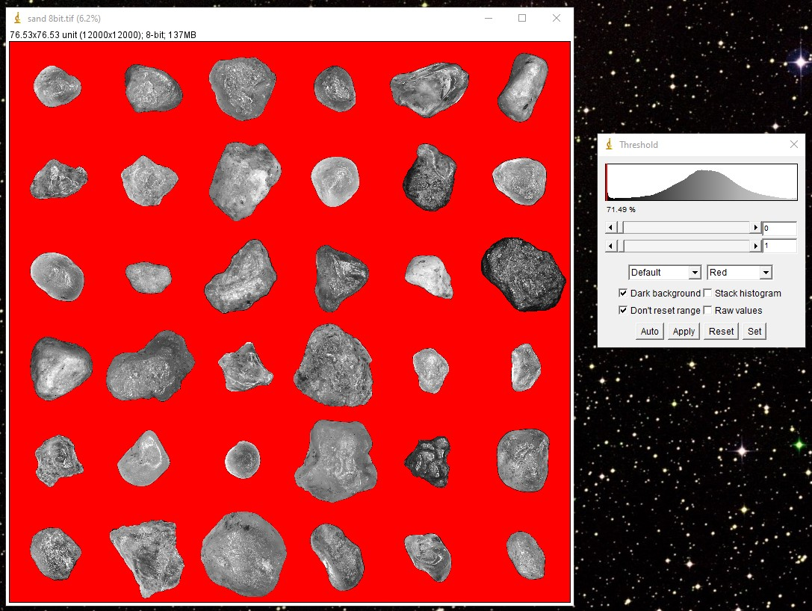
RESULTS & ANALYSIS
Applying threshold and binarizing
Since the background is black, it is easy to pick it out the histogram.
The image is then binarized to make sure that there are only two values for easier extraction of geometric features.
Codes and files: https://github.com/genvert/AP_157_FX-2_Vertudez/tree/main/Activity%202

Slide 7
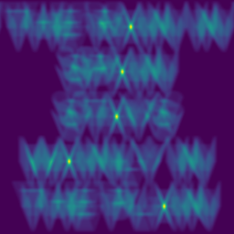
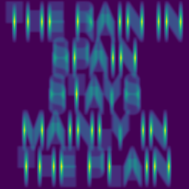
RESULTS & ANALYSIS
Correlating an image with another
Correlating two functions is equal to multiplying their Fourier transforms, but this time the other is complex conjugate.
Correlation measures the degree of similarity of the functions
The results make sense since when the phrase was correlated with a letter, the result show the points where the functions (in this case images) are similar
Codes and files: https://github.com/genvert/AP_157_FX-2_Vertudez/tree/main/Activity%202

Slide 8
REFLECTION
This activity was straightforward so I was able to follow it easily.
It is cool that the pixels can act as Dirac delta functions such that other images are copied to each pixel when convolved.
I managed to do it on time this time.
I give myself a 10/10.

